Slide 1

Project 7: Deep Fake
CS-SCI 5530-003
Principles of Data Science
Prof. Syed Jawad Shah
Team members:
Naga Sahithi Vunnam - 16355633
Shiva Reddy Dubbaka - 16352875
Varshith Gandhe - 16354840
Karthikeya Arra - 16354793

Slide 2
Introduction
Deepfake technology has revolutionized digital media, offering both opportunities and challenges.
Leveraging advanced AI algorithms, deepfakes convincingly alter images and videos.
They seamlessly manipulate facial expressions, gestures, and speech to create realistic yet entirely fake content.
Deepfakes have potential for entertainment and artistic expression but carry inherent risks.
They jeopardize the authenticity and reliability of visual information.
Trust in digital media is compromised as deepfakes blur the lines between truth and fiction.

Slide 3
Problem Statement & Objective
Problem Statement:
Proliferation of Deepfake content.
Manipulate public opinion.
Objective:
Develop and evaluate deep learning models for the classification of deepfake.

Slide 4
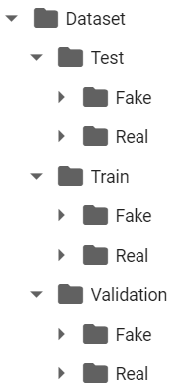
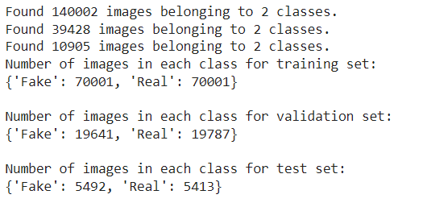
Related work
Took an Image dataset from Kaggle
https://www.kaggle.com/datasets/manjilkarki/deepfake-and-real-images
It has like 3 directories
Contains a total of 1,90335 and size of 2GB
No class imbalance issue.
Unique image size of (256x256) and in jpg format.

Slide 5
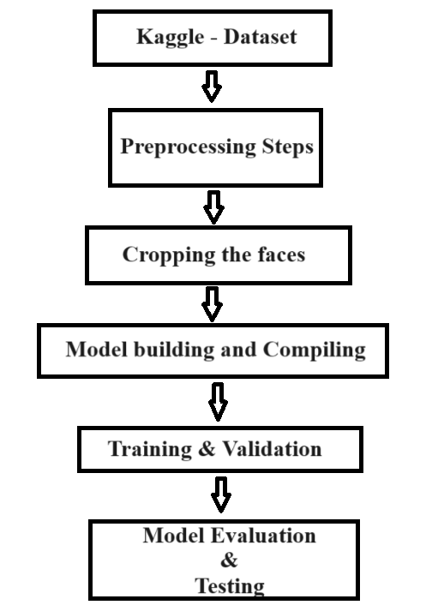
Methodology

Slide 6
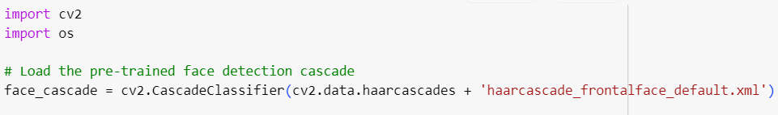
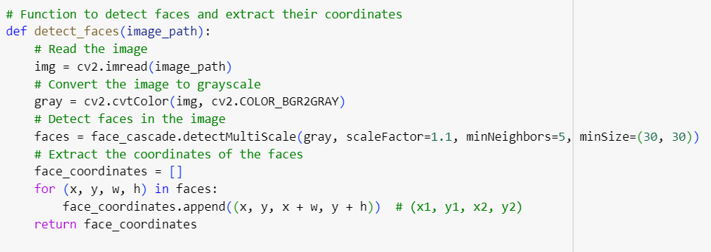
Code
Cropping images Code:

Slide 7
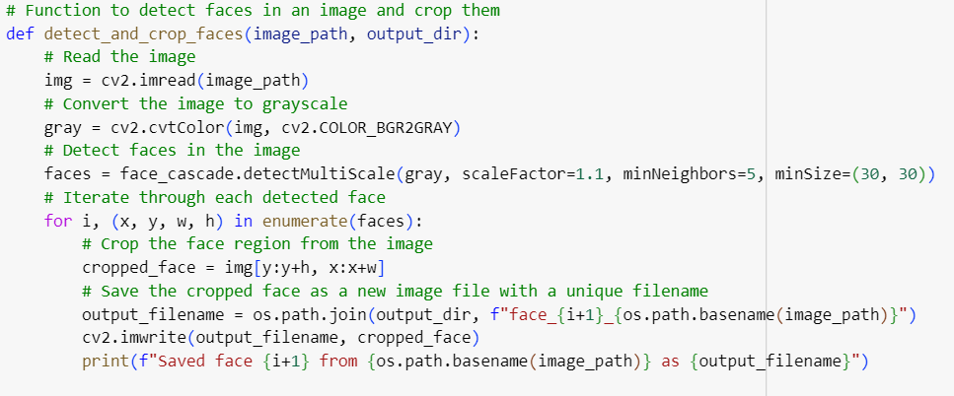
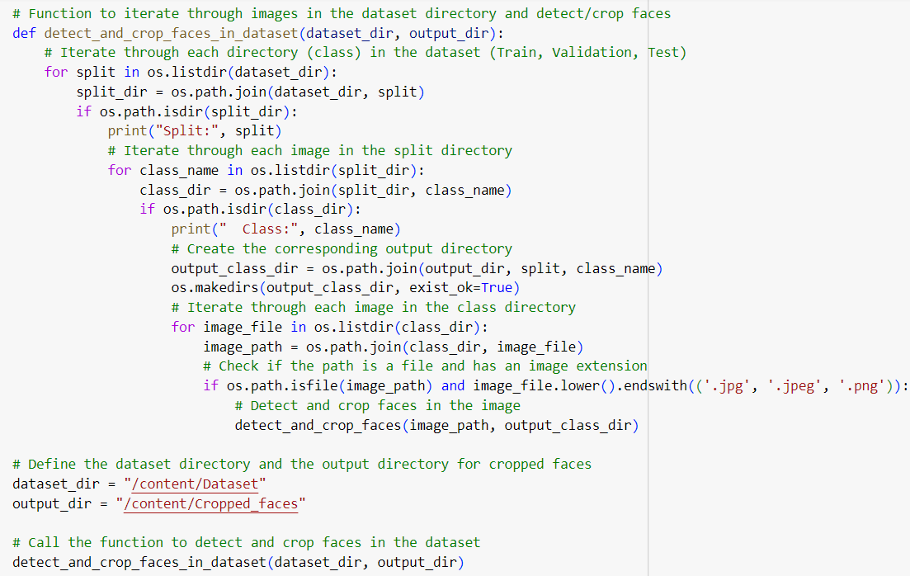

Slide 8
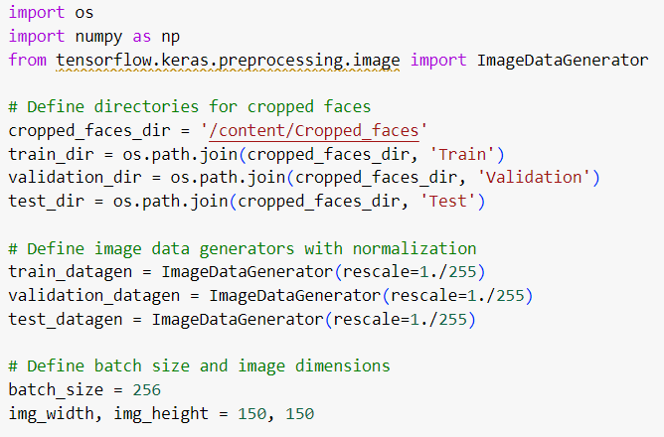
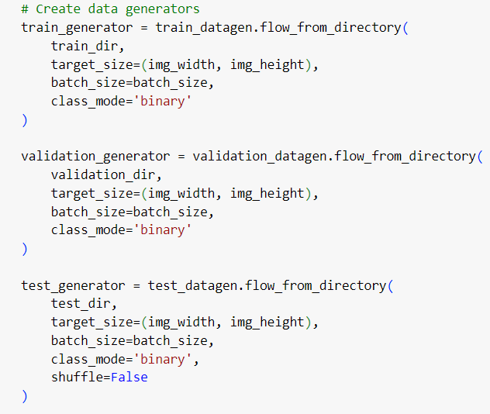
Model building & Compiling:

Slide 9
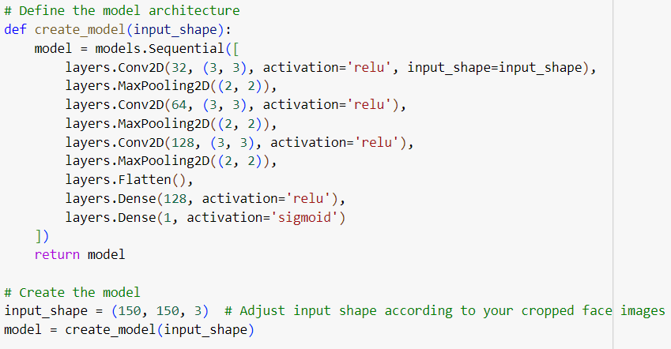
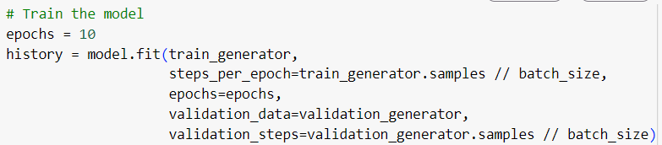

Slide 10
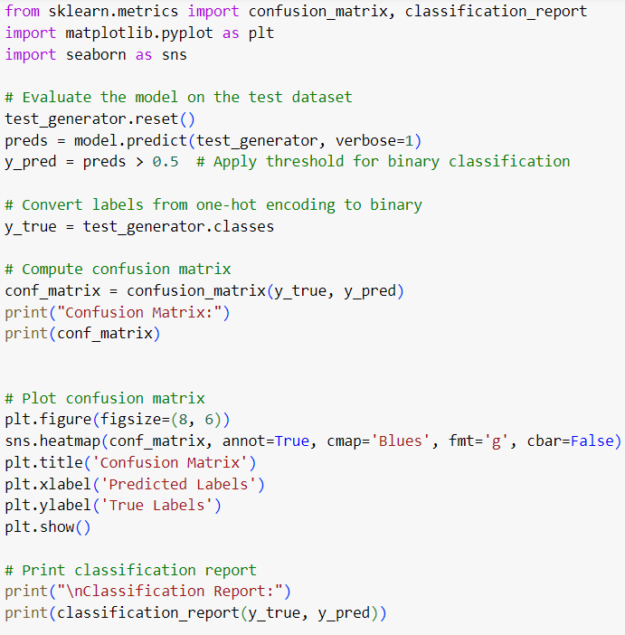
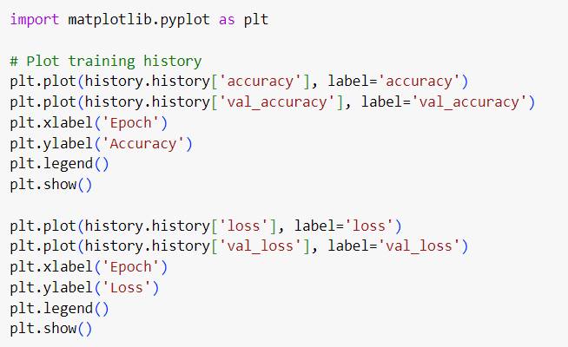
Results & Discussions

Slide 11
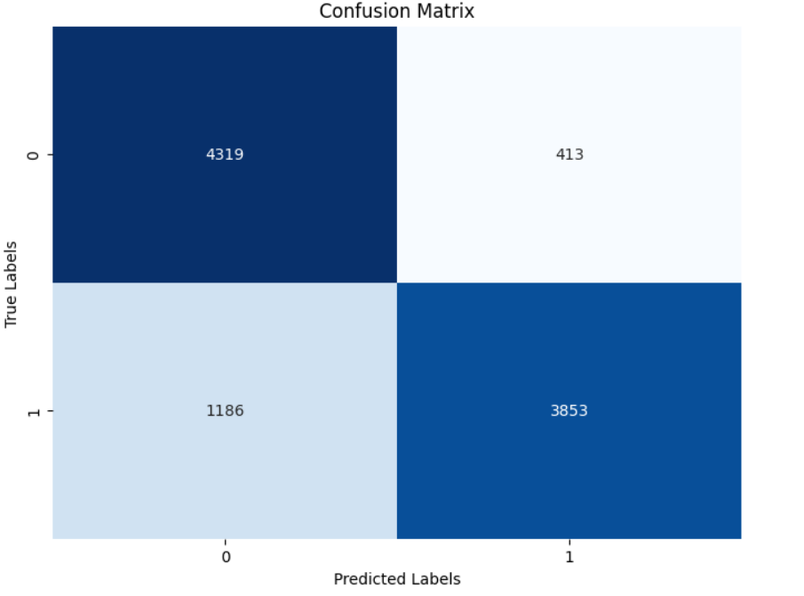
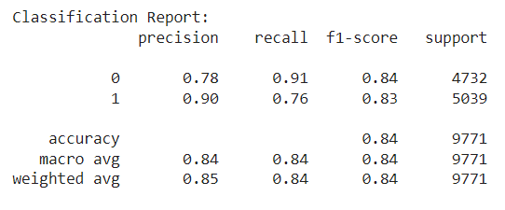

Slide 12
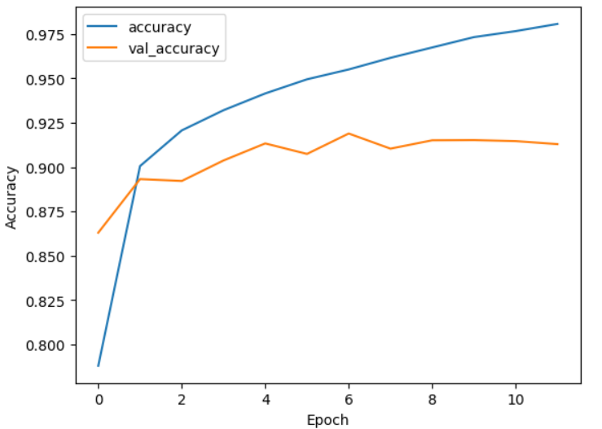
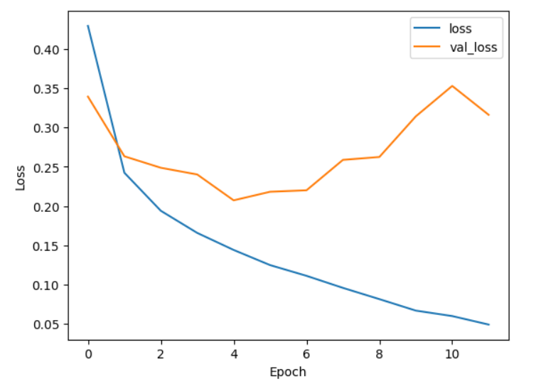

Slide 13
Conclusion
The project successfully developed and evaluated a deep learning model for detecting deep fake images with high accuracy and precision.
The model's performance metrics demonstrate its effectiveness in distinguishing between real and fake images, thereby addressing the pressing need for reliable deep fake detection methods.

Slide 14


